Slide 1
Comparative Study of Techniques for Imputation of Missing Data in Datasets
Submitted by :- Nilratan Sarkar(ADTU/L/2018-22/BCS/017) Semester :- 8th sem , Department :- B.Tech(C.S.E) Guided by : - Dr. Manoj Kumar Sarma

Slide 2
TABLE CONTENTS
INTRODUCTION................................................................................................................................................................... 3
What is Imputation?............................................................................................................................................................ 4
What is a Missing Data?...................................................................................................................................................... 5
Missing Data Mechanisms................................................................................................................................................... 6
Results of missing value....................................................................................................................................................... 7
The imputation techniques implemented............................................................................................................................. 8-9
Performance Evaluation Metrics........................................................................................................................................... 10
Table : - Results of the imputation techniques...................................................................................................................... 11
Fig .1 : - Graphical comparison of Root Mean Square Error(RMSE) of the imputation techniques............................................................................................................................................................................ 12
Fig .2 :-Graphical comparison of Mean Absolute Error(MAE) of the imputation techniques............................................................................................................................................................................ 13
Fig .3 : - Graphical comparison of Mean Absolute Percentage Error(MAPE) of the imputation
techniques....................................................................................................................................................................................14
Screenshots...........................................................................................................................................................................15-21
Technologies used..................................................................................................................................................................22-23
Software and Hardware Requirements..................................................................................................................................24
Conclusion..............................................................................................................................................................................25

Slide 3
INTRODUCTION
Missing data (MD) are a common problem in data science job. When ignored or treated not appropriately, MD can lead to seriously biased results.
The objective of this project is to do a comparative study of multiple imputation methods by implementing on a dataset .

Slide 4
What is Imputation?
Imputation is a technique used for replacing the missing data with some substitute value to retain most of the data/information of the dataset.
These techniques are used because removing the data from the dataset every time is not feasible and can lead to a reduction in the size of the dataset to a large extend.

Slide 5
What is a Missing Data?
Missing data is defined as the values or data that is not stored (or not present) for some variable/s in the given dataset.

Slide 6
Missing Data Mechanisms : -
Missing Completely At Random(MCAR) : - This is when missing data observations are not relient on the observed and unobserved measurements.
Missing At Random(MAR) : - The likelihood of a missing value in MAR is only related to observable data .
Missing Not At Random(MNAR) : - This refers to when missing data is neither MCAR nor MAR .The missing data depends equally on the missing & observed values.

Slide 7
Results of missing value : -
Performance degradation
Data analysis problems
Biased outcomes

Slide 8
The imputation techniques implemented : -
Simple imputer : -
It is a statistic based approach in which a statistic(such as mean) is calculated from each column with missing values and then all missingvalues are replaced with the calculated statistic .
Iterative Imputer : -
Iterative imputer is a multivariate imputer ,that means it estimates each features from all others.
Multiple Imputation by Chained Equations (MICE) : -
MICE works under the presumption that the variables used in theimputation technique, the missingness of the data are Missing At Random(MAR), which means that the possibility that a
value is missing depends only on observed values and not on unobserved values.

Slide 9
K nearest neighbour(KNN) Imputer : -
The logic behind KNN methods is to identify ‘k’ samples in the data-set that are similar or close in the space. Then we use these ‘k’ samples to estimate the value of the missing data points.
MissForest Imputer : -
First , the missing values are filled using median/mode imputation method.Then we mark the imputed values as ‘Predict’ and the others as trainingrows, which are then put into a Random Forest model trained to predict the missing values .

Slide 10
Performance Evaluation Metrics : -
Root Mean Square Error (RMSE) : -
Root Mean Square Error calculates mean in the difference between the imputed values and the actual values .
Mean Absolute Error (MAE) : -
Mean Absolute Error calculates the mean of the absolute difference between the imputed values and the actual values.
Mean Absolute Percentage Error(MAPE) : -
Mean Absolute Percentage Error calculates the total percentage of Mean Absolute Error .

Slide 11
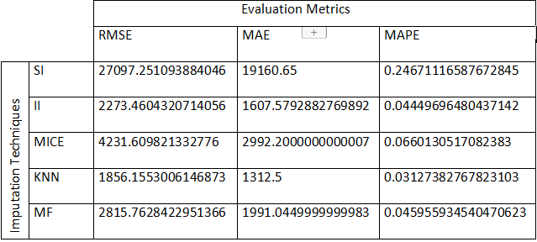
Results : -
Table : - Results of the imputation techniques .

Slide 12
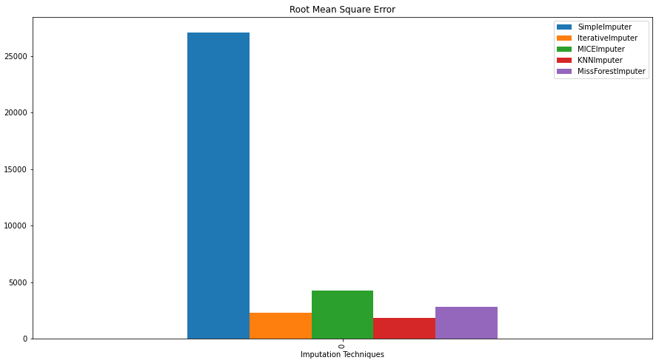
Fig .1 : - Graphical comparison of Root Mean Square Error(RMSE) of the imputation techniques .

Slide 13

Fig .2 :-Graphical comparison of Mean Absolute Error(MAE) of the imputation techniques.

Slide 14
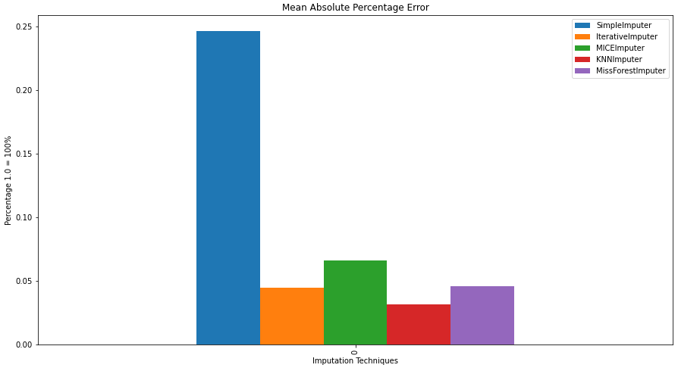
Fig .3 : - Graphical comparison of Mean Absolute Percentage Error(MAPE) of the imputation techniques .

Slide 15
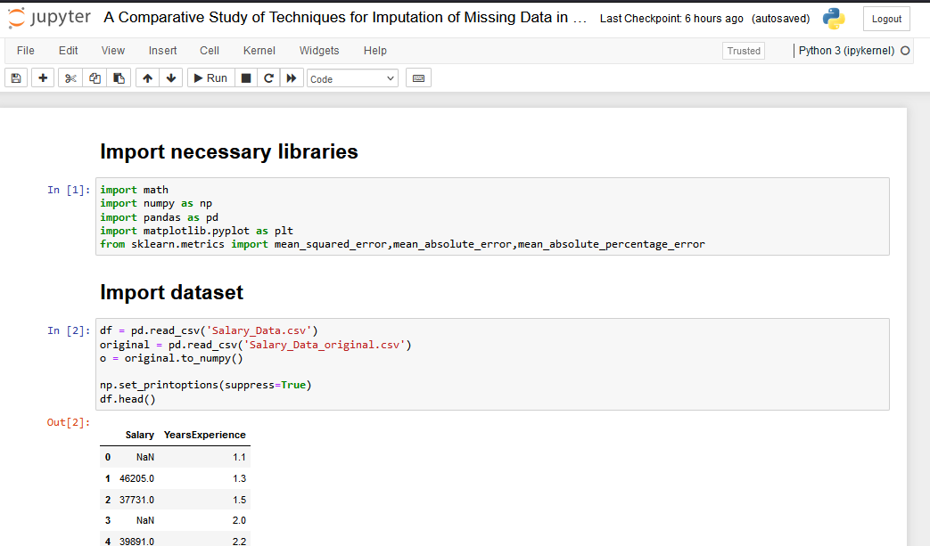
Screenshots : -

Slide 16
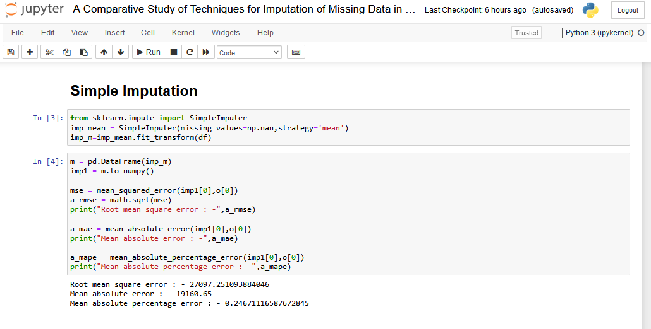

Slide 17
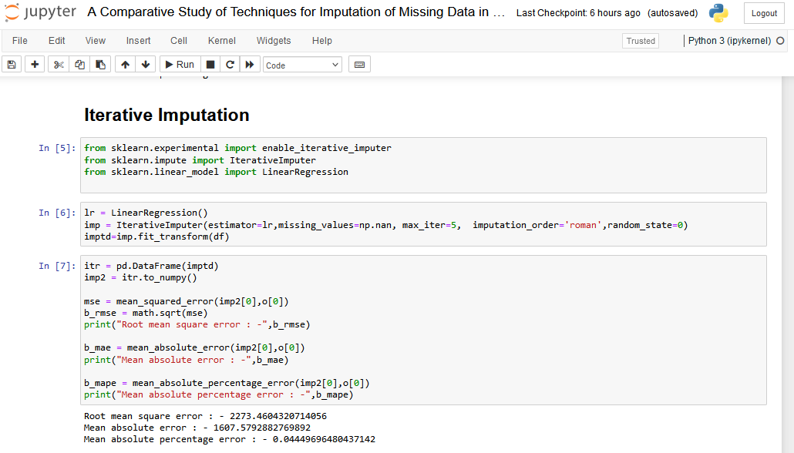

Slide 18
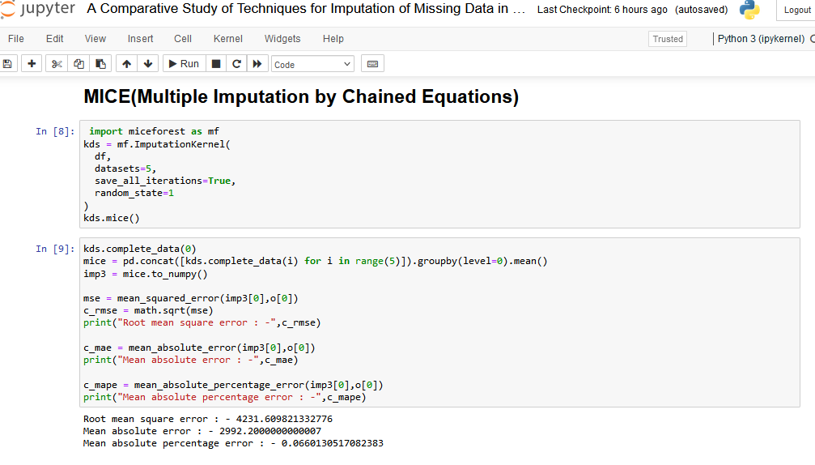

Slide 19
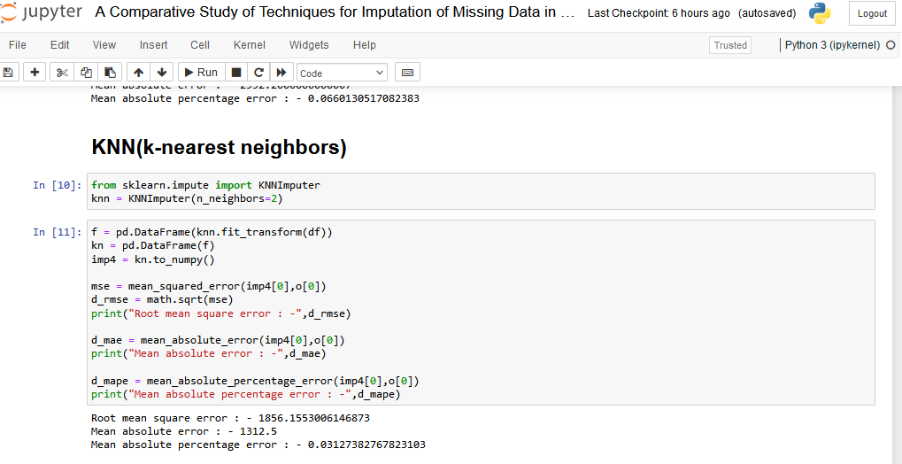

Slide 20
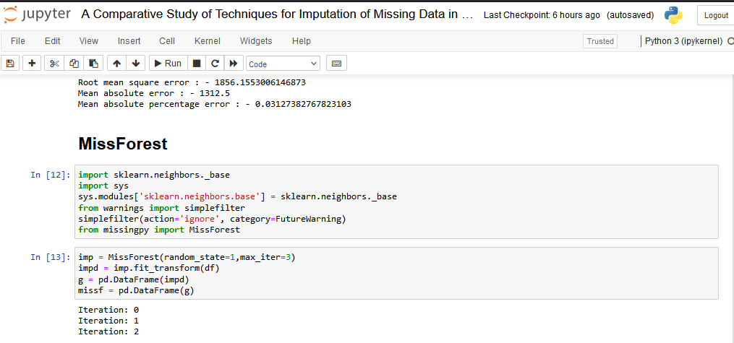

Slide 21
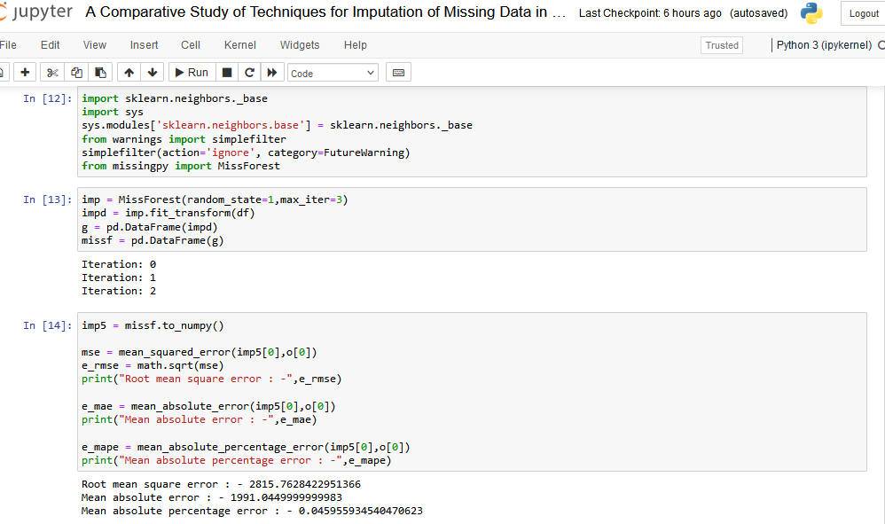

Slide 22
Technologies used : -
Python :- Python is often used to build websites and software, automate tasks, and conduct data analysis,data visualisation,AI and machine learning.
Jupyter Notebook : - The Jupyter Notebook App is a server-client application that allows editing and running notebook documents via a web browser.
➢ Libraries used : -
Numpy : - NumPy is library in python used for working with arrays. It also has functions for working in domain of linear algebra, fourier transform, and matrices.

Slide 23
2. Pandas : - Pandas is a library in Python for data analysis and manipulation .
3. scikit-learn(sklearn) : - Scikit-learn is a free software machine learning library for the Python programming language. It features various classification, regression and clustering.

Slide 24
Software Requirements : -
Anaconda Individual Edition
python 3 or higher
Hardware Requirements : -
2 CPU cores
2GB Ram or Higher.
20 GB HDD or Higher.
Free space required 1.5GB .

Slide 25
CONCLUSION
This project helped me understand missing data, reason for their missingness ,different kinds of missingness, handling missing values using imputations

Slide 26
Thank You

